Slide 1
CS315 – Project Two
Nova
Evan Drake
https://github.com/EvanDrake725/Game2

Slide 2
Sources
Scene Transitions: https://www.youtube.com/watch?v=Shj_QVwrefY
Enemies: https://www.youtube.com/watch?v=_QrMqFmrF5o&t=44s
Sword/Shooting: https://www.youtube.com/watch?v=hJaZag6A44o
Kinda room stuff (I changed almost everything but still) :https://www.youtube.com/watch?v=v3v01p26NP0&list=PL3cGrGHvkwn0zoGLoGorwvGj6dHCjLaGd&index=7
Also big thanks to Daniel Warren Johnson for art inspiration and You are not Bunny Girl for getting me out of an idea rut.

Slide 3
Milestone 1
By this point you should have completed:
  Player movement and interaction
  Level design and layout
  Collectibles
  One bit of interactivity
At this point I just got out of the idea rut so I didn’t have a lot.

Slide 4
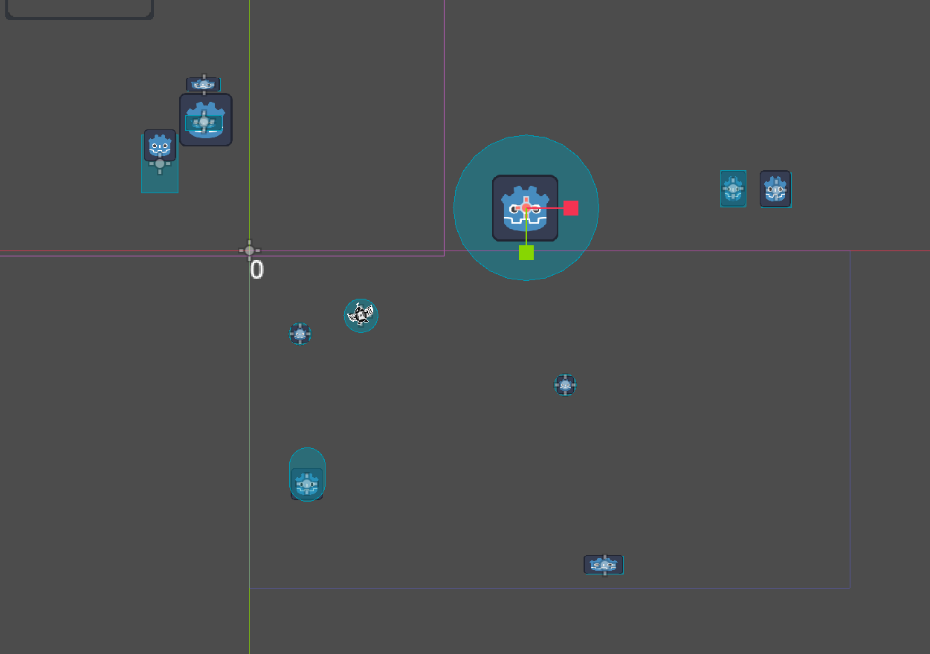
M1 – Screenshot / image
Thought to add this here: the little helper guy really is effecting this game. I realized I can have this little follower and how like half the gameplay revolves around him. Love the goober.

Slide 5
M1 – Question
Add an open question you have about your project
A question I have for my game is how to make interesting level layouts? An area I struggle with is actually laying everything out in a neat and fun way. Hoping that isn’t the case here.

Slide 6
M1 – Discussion
Delete this and add 2-3 takeaways from your discussion with your peer. Consider these elements:
  Level pacing : Group says it sounds good if done effectively. I at the moment don’t have things down where needed so it is a little hard to fully show off my plan. So main takeaway is to focus on design and pacing.
  Keeping track of code connections : Lot more clean then project 1. They like that things are in more specialized folders. They also think the code looks better and more organized.
  Adding in hooks for game feel : The ability to control the little guy as a separate controller. Add more to the combat ie actual animations. Since mine looks simple they said it is hard to fully picture what I am thinking.

Slide 7
M1– Technique Reflection
I would say I am growing quite a bit. For project 1 I forgot what @export did but now that I remember it I can work a lot more efficiently. Also I have gotten better at being able to guess if code will work based on reading it as opposed to testing every 5 seconds.

Slide 8
Milestone 2
By the point you should have completed:
  Doors / collectibles finished
  User interface
  Enemies added
  Some “juice”
I was fully out of the idea rut here and full steam ahead. Not everything was there on thursday but a good chunk.

Slide 9
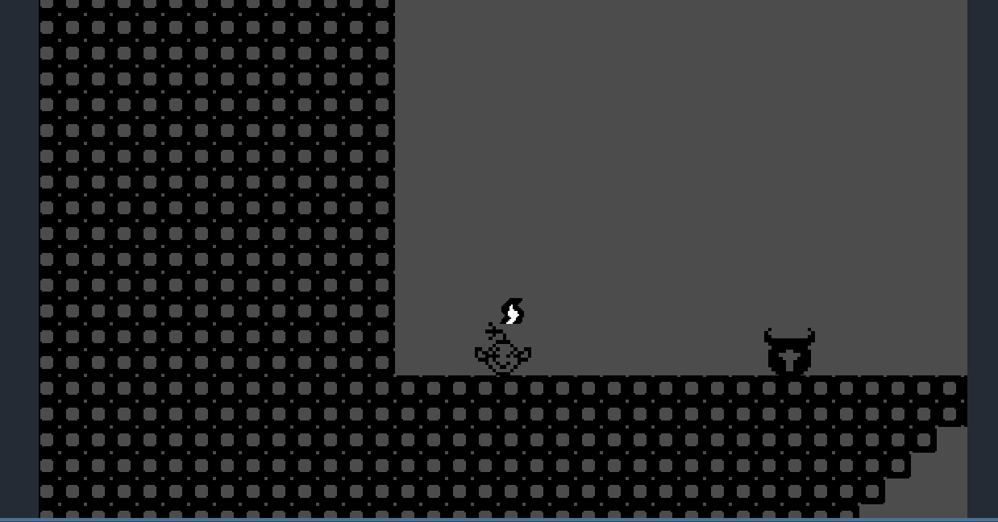
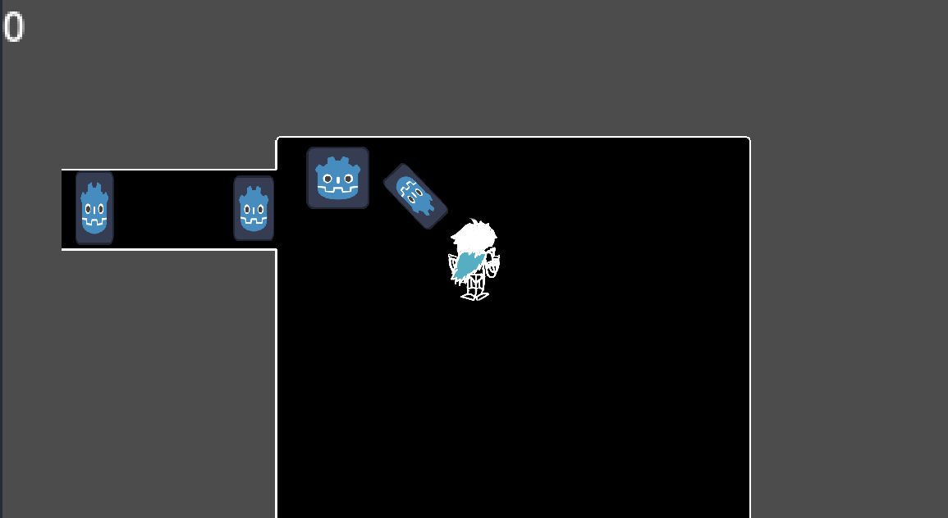
M2 – Screenshot / Image
Add a screenshot(s) of your project

Slide 10
M2 - Question
A question I have about my game relates to the looks of it. Is it to bland or is it an eye sore? When I showed it to my friends they thought the shades of blue I used weren’t good so that is why I changed it to the all black look with hints of blue. The look of a game is really important to me so I hope mine looks fine.

Slide 11
M2 - Discussion
Discuss these elements of your game
  I used the godot website and youtube videos.
  I decided on the quality by reading comments and basing off of that.
  The dynamics of the game is between the player and the enemies, and the player and the BUDD1 droid. The Player and enemies interact by them dealing damage in an attempt to destroy you and you hurt them to destroy them. With the BUDD1 droid he follows you and now with him can hack terminals to open doors. The mechanics are walking, sword swinging, interacting, jumping, and hacking the terminals. As for aesthetics you are in a war robot factory and get to the core to destroy it. The black and white adds a bleak feel to it.

Slide 12
M2 Reflection
I am mostly struggling with the room teleportation and enemies dropping stuff. Both give errors that I am trying to fix. Also for room transitioning I am working on it remembering where you were last time you were in the room as opposed to restarting you each time. Also
as mentioned I am working hard on making the game look good.

Slide 13
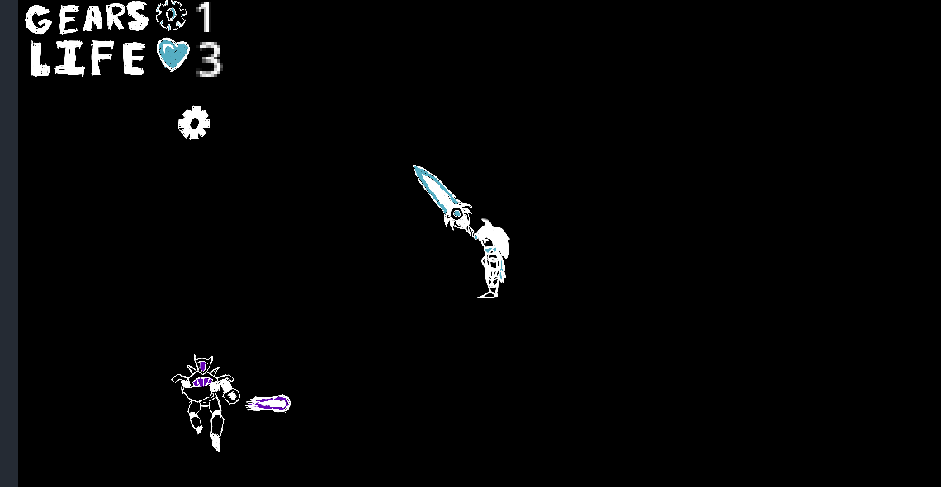
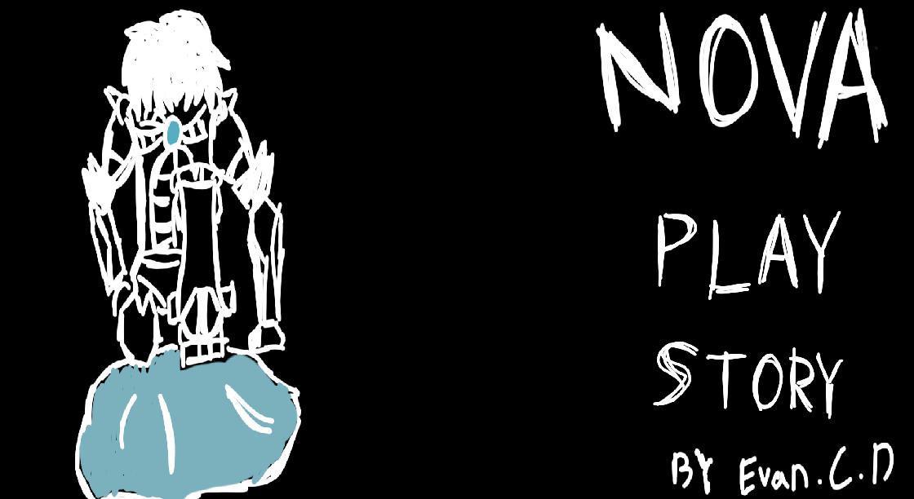
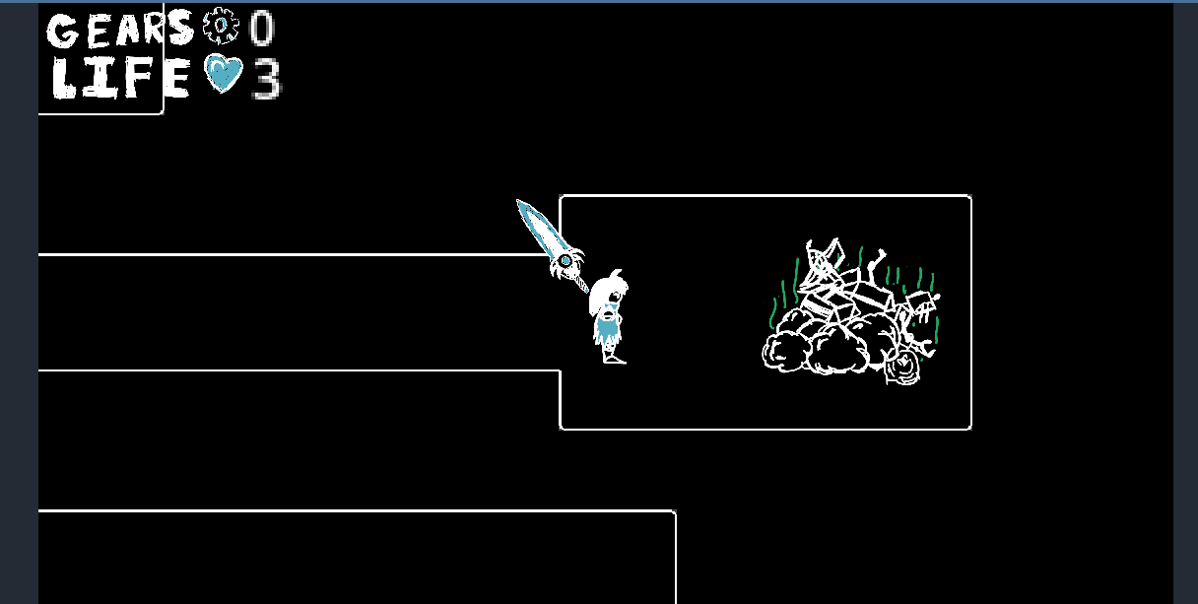
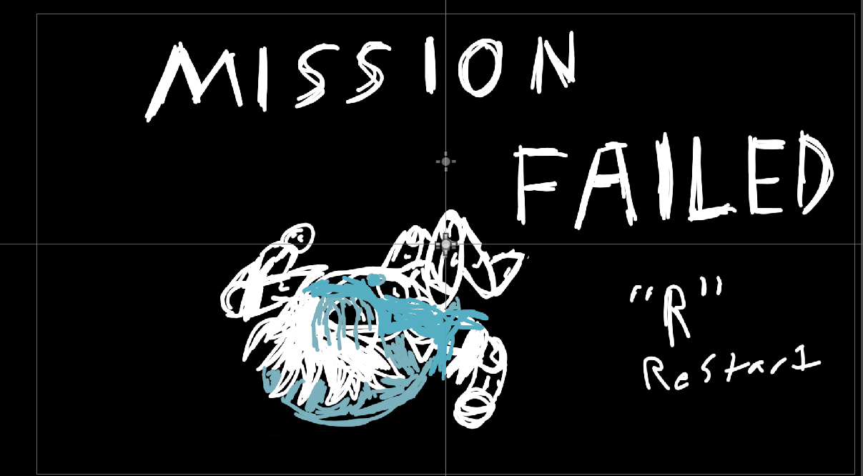
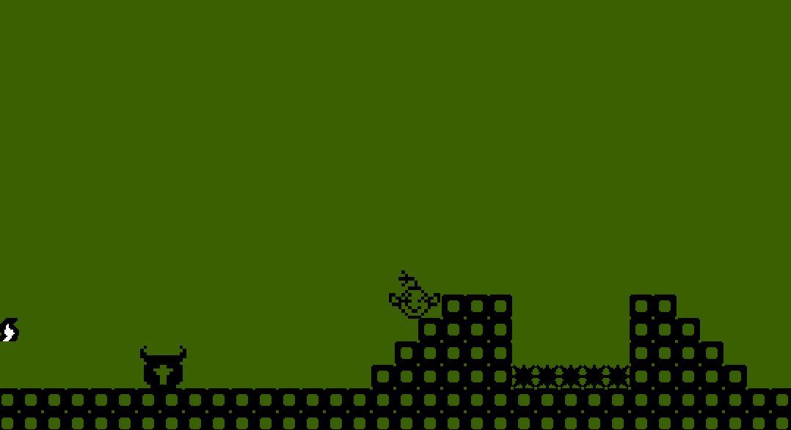
P2 – Final Reflection
Above: Favorite shot from the game. Skybound Bumblebee inspired
<-Gameboy inspired look

Slide 14

The Video (Don't pay attention to how much I suck at platformers)
Some notes: This is technically an old build since I later added some random sprites and such to decorate. Also to make excuses for my horrible performance in the platforming bit, 1. I was tired 2. My roommate was teaking at TF2.

Slide 15
P2 – Final Reflection
Technique & Aesthetics: For techniques I learned a lot more on the technical side. I relearned @export and also learned way easier ways to call objects. the “$” way is a whole lot easier then path searching. As for aesthetics when I hear that I think looks and such. I would say I am improving in that regard. I'm curious your thoughts on the art and look, cause I may try to do hand drawn again in the future.
Major difficulties: The main difficulties were my inability to decide and then the room transitions. Room transitions looking back were very easy and I am a little upset I didn’t think of it sooner.
Future: In the future I will think of ideas sooner so that I can actually have time. Once I get going I get going but it takes a sec for that engine to start. Also it’ll help with asset making since that takes eons.

